Slide 1

  Design and Development of an Intelligent Cloud Disaster Recovery System for Enterprise IT Infrastructure
  Team no. 3
  CSA1520– Cloud computing and Big Data analytics
  Guided By Students Name
  Dr.A.M.Arul Raj Yashmita G (192511032)
  Professor Sanjana G (192511020)
  Pavithra V (192524274)
  Dharshana D (192524243)
  Turlapati Anurupa (192524160)
Notes:
1
1

Slide 2
Abstract
Cloud service disruption and unexpected downtime
Distributed backup storage across cloud regions
Continuous health monitoring of services and resources
Analytics-based outage detection and recovery decisions
Automated failover to healthy standby infrastructure
Data consistency checks and recovery status reporting

Slide 3
Aim and Objective
Aim
To develop an analytics-driven system that detects cloud failures and performs intelligent disaster recovery automatically.
Objectives
Monitor cloud services and infrastructure continuously.
Detect anomalies and predict potential cloud failures.
Maintain replicated backups across cloud environments.
Automatically switch workloads to a healthy standby cloud.
Generate alerts and maintain recovery logs.20

Slide 4
Introduction
Cloud computing provides scalable storage, applications, and services.
Cloud failures can cause downtime and data loss.
Traditional recovery methods may depend on manual intervention.
Predictive analytics helps identify potential failures early.
Intelligent failover redirects services to a standby cloud.
This project combines monitoring, prediction, backup, and automated recovery.

Slide 5
Literature Review
S.No | Year of Publication | Author | Title of the Journal / book | Methodology used | Algorithm used | Key Findings
1 | 2023 | Raghava Chellu | AI-Powered Intelligent Disaster Recovery | Cloud telemetry analysis | LSTM | Predicts failures and improves recovery.
2 | 2023 | Hassan Raza | Driven Disaster Recovery in Distributed Cloud Systems | Predictive monitoring | LSTM, Federated Learning | Supports proactive recovery and resource optimization.
3 | 2024 | Figen Özen & Alireza Souri | Cloud-Based Disaster Management Architecture | Hybrid machine learning | Hybrid ML | Improves disaster assessment using cloud and IoT data.
4 | 2025 | Sathish Kuppan Pandurangan | Advanced Disaster Recovery System in Cloud Infrastructure | Backup and replication | Automated orchestration | Supports multi-region recovery and business continuity.
5 | 2026 | Kun Meng | Cloud Disaster Recovery Model Based on Failure Prediction | Time-series prediction | ED-LSTM | Predicts failures and reduces recovery time.

Slide 6
Problem Statement
Cloud failures can interrupt services and affect business continuity
Manual detection and recovery increase response time
Separate monitoring and backup tools complicate recovery coordination
Unverified failover may redirect traffic to unhealthy resources
Need: analytics-driven outage detection and controlled recovery orchestration
Target outcomes: lower recovery time, limited data loss and improved availability

Slide 7
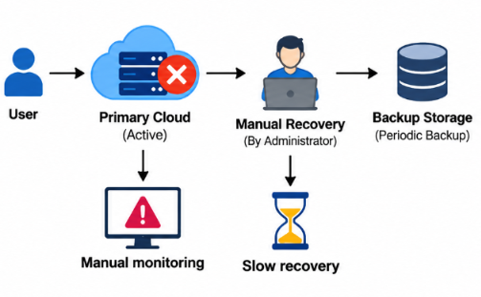
Existing System
Periodic monitoring of cloud resources and services.
Scheduled backups and regular data replication.
Manual failure detection and recovery operations.
Static failover rules for service restoration.
Limited predictive analysis and recovery validation processes.

Slide 8
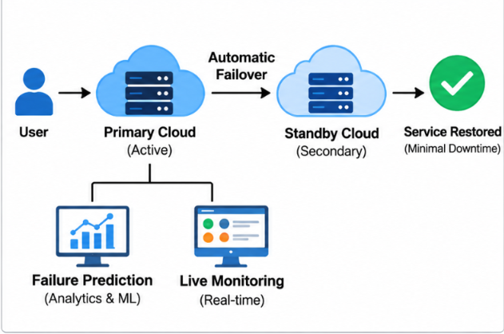
Proposed System
Real-time cloud monitoring and telemetry collection.
Analytics-based anomaly and failure prediction.
Replicated backups across cloud regions.
Automated failover to a healthy standby cloud.
Recovery validation, alerts, and performance reports.

Slide 9
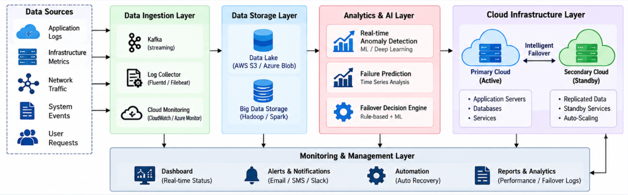
Overall System Architectural Design

Slide 10




Sustainable Development Goal (SDG) Implementation
SDG 9 - Industry, Innovation and Infrastructure
Strengthens cloud infrastructure against unexpected failures.
Improves system reliability through intelligent disaster recovery.
SDG 11 - Sustainable Cities and Communities
Ensures continuous digital services during system failures.
Enables faster recovery of critical urban IT services.

Slide 11
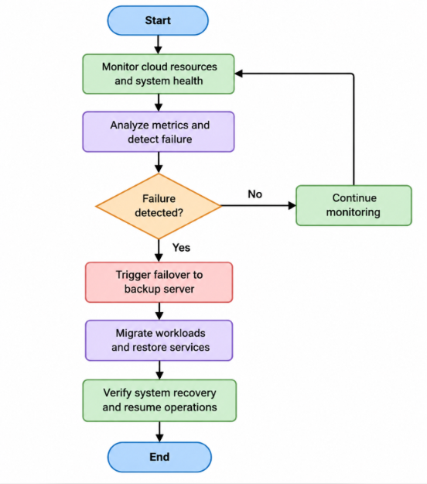
Proposed Methodology and Algorithm
Algorithm: Analytics-Driven Intelligent Failover and Disaster Recovery Algorithm

Slide 12
Design & Module Planning
Module 1 – Telemetry Collection: service probes, logs and cloud metrics.
Module 2 – Analytics & Detection: thresholds, trend analysis and anomaly score.
Module 3 – Backup & Replication: snapshots, replication lag and recovery points.
Module 4 – Failover Orchestration: policy evaluation, target selection and traffic switch.
Module 5 – Dashboard & Reporting: live status, alerts, recovery history and audit logs.

Slide 13
Module 1 – Telemetry Collection and Infrastructure Monitoring
Objective: To monitor cloud infrastructure and collect real-time performance data.
Data Collection: Gather CPU usage, memory, network traffic, and storage metrics.
Health Monitoring: Check server availability and application status.
Log Management: Collect system logs and error messages.
Data Aggregation: Organize monitoring data for further analysis.
Outcome: Provides centralized infrastructure monitoring and helps identify system issues early.

Slide 14
Module 2 – Analytics and Failure Prediction
Objective: To analyze infrastructure data and identify potential failures before they cause major disruptions.
Threshold Analysis: Detect performance values that exceed predefined limits.
Trend Analysis: Analyze historical data to identify unusual patterns.
Anomaly Detection: Identify abnormal system behavior.
Risk Assessment: Calculate risk levels and generate alerts for potential failures.
Outcome: Enables early failure detection and supports proactive decision-making.

Slide 15
Module 3 – Backup and Disaster Recovery
Objective: To protect critical data and ensure its availability during unexpected failures.
Automated Backup: Schedule regular backups of important data.
Data Replication: Maintain copies of data on secondary systems.
Snapshot Management: Save system states for recovery when needed.
Recovery Planning: Define recovery points and restoration procedures.
Outcome: Minimizes data loss and supports reliable system restoration.

Slide 16
Module 4 – Failover and Service Continuity
Objective: To maintain service availability by switching operations to backup systems when failures occur.
Failure Detection: Identify unavailable servers and services.
Backup System Selection: Select a healthy secondary system.
Automatic Failover: Redirect services to the recovery system.
Service Validation: Verify that services are running correctly after failover.
Outcome: Reduces downtime and maintains business continuity during infrastructure failures.

Slide 17
Module 5 – Dashboard, Alerts and Reporting
Objective: To provide a centralized interface for monitoring infrastructure and managing recovery operations.
Live Dashboard: Display system health, performance metrics, and service availability.
Alert Notifications: Notify administrators about failures and critical events.
Audit Logs: Maintain records of system events and administrative actions.
Outcome: Improves infrastructure visibility, simplifies management, and supports faster incident response.

Slide 18
Conclusion
Enhances cloud infrastructure reliability through intelligent failover mechanisms.
Uses real-time analytics to detect failures and support faster recovery decisions.
Minimizes service downtime by automatically switching to backup cloud resources.
Ensures business continuity and improves the availability of critical digital services.
Supports SDG 9 and SDG 11 by promoting resilient infrastructure and reliable digital services.

Slide 19
References
NIST, “Security and Privacy Controls,” 2020. https://doi.org/10.6028/NIST.SP.800-53r5
Amazon Web Services, “Disaster Recovery of Workloads on AWS,” 2021. https://shorturl.at/aws-dr
E. B. Khiyami and S. Shanker, “Building a Disaster Recovery Site on AWS for Workloads on Microsoft Azure,” AWS, 2023.https://shorturl.at/multicloud-dr.
Google Cloud, “Architecting Disaster Recovery for Cloud Infrastructure Outages,” 2024. https://shorturl.at/cloud-dr
Amazon Web Services, “Disaster Recovery Options in the Cloud,” AWS. https://shorturl.at/aws-dr
Google Cloud, “Disaster Recovery Scenarios for Applications,” 2024. https://shorturl.at/gcp-app
Google Cloud, “Disaster Recovery Building Blocks,” 2024. https://shorturl.at/gcp-blocks

Slide 20


